Slide 1
SOLID PRINCIPLE
Design Concepts

Slide 2
What is SOLID
The SOLID principles are five essential guidelines that enhance software design, making code more maintainable and scalable.
The SOLID principles help in enhancing loose coupling. Loose coupling means a group of classes are less dependent on one another.
Loose coupling helps in making code more reusable, maintainable, flexible and stable. Now let's discuss one by one these principles...
Loosely coupled classes minimize changes in your code when some changes are required in some other code.

Slide 3
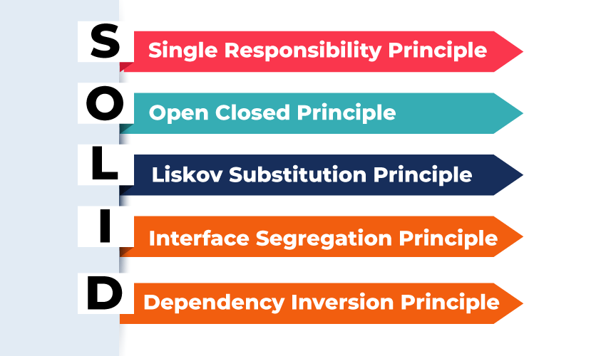
What is solid

Slide 4
Single Responsibility
Single Responsibility Principle
This principle states that "A class should have only one reason to change" which means every class should have a single responsibility or single job or single purpose. In other words, a class should have only one job or purpose within the software system.
Let's understand Single Responsibility Principle using an example:

Slide 5
Open and close
Open/Closed Principle
This principle states that "Software entities (classes, modules, functions, etc.) should be open for extension, but closed for modification" which means you should be able to extend a class behavior, without modifying it.
Let's understand Open/Closed Principle using an example:

Slide 6
Liskov's Substitution Principle
The principle was introduced by Barbara Liskov in 1987 and according to this principle "Derived or child classes must be substitutable for their base or parent classes". This principle ensures that any class that is the child of a parent class should be usable in place of its parent without any unexpected behaviour.

Slide 7
Interface Segregation Principle
This principle is the first principle that applies to Interfaces instead of classes in SOLID and it is similar to the single responsibility principle. It states that "do not force any client to implement an interface which is irrelevant to them". Here your main goal is to focus on avoiding fat interface and give preference to many small client-specific interfaces. You should prefer many client interfaces rather than one general interface and each interface should have a specific responsibility.
Let's understand Interface Segregation Principle using an example:

Slide 8
Dependency Inversion Principle
The Dependency Inversion Principle (DIP) is a principle in object-oriented design that states that "High-level modules should not depend on low-level modules. Both should depend on abstractions". Additionally, abstractions should not depend on details. Details should depend on abstractions.
In simpler terms, the DIP suggests that classes should rely on abstractions (e.g., interfaces or abstract classes) rather than concrete implementations.
This allows for more flexible and decoupled code, making it easier to change implementations without affecting other parts of the codebase.

Slide 9
Exercises
Design classes for Banking system where you need to cover below use cases
1:Customer login
2:Fund transfer
3:Balance check
4:Check processing
5:Statements
6:Adding and deleting bene

